Slide 1
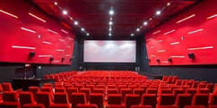
Online Movies Booking System Web Application
Ashish Pokhrel
00172912
Computing Project

Slide 2
Introduction
Online movie Booking System is web portal.
User can book movie ticket from web browser.
User Friendly.

Slide 3
Problem Statements
Chances of duplication of Ticket.
User should sit on long queue.
Current system is Time consuming and complex system

Slide 4
Aims Of Project
Main aims of Online movies system is to best way to movies booking to Cinema Hall.
It is alternative to manual booking.
It can also help to promote movie in internet.
User can know details of movies easily.

Slide 5
Objectives Of Project
Allows users to know movies details, schedule showtime, price, etc.
Helpful for management for decision making.
Provide anytime anywhere service to customers.
User Friendly

Slide 6
Features
Login/Registration
Book movie ticket for movie hall.
Cancel Booking
Admin can do crud operations.
Details of running and upcoming movies with showtime.

Slide 7
Work Break Down Structure
Process of dividing into complex project into simple and manageable tasks.
Usually done by project manager.

Slide 8
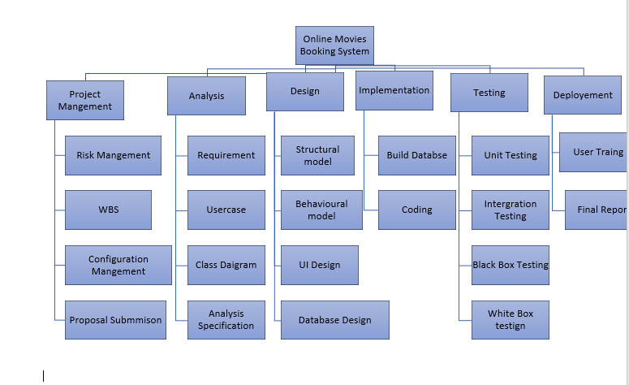
Work Break Down Structure

Slide 9
Gannt Chart
Develop by American engineer Henry L. Gantt in 1917
Graphically illustration of a schedule that can plan ,coordinate and track specific tasks in project.
Example: Microsoft Project, Project Libra etc.

Slide 10
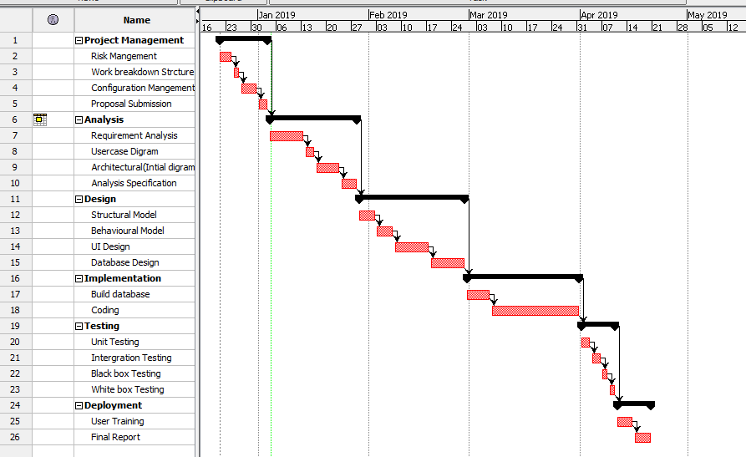
Gannt Chart

Slide 11
Development Methodology (Waterfall Methodology)
first SDLC in software engineering
Simple and easy to understand.
Also called as linear-sequential life cycle model

Slide 12
Waterfalls Methodology
Six phrases:
Requirement Analysis
System Design
Implementation
Testing
Deployment
Maintenance

Slide 13
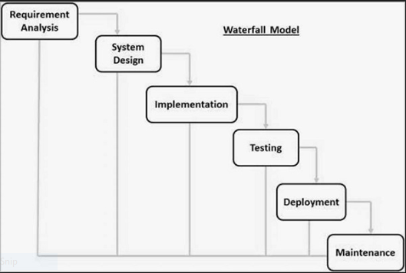
Waterfalls Methodology

Slide 14
Design Pattern(MVC)
Model View Controller
Structural design pattern
Model: interact with database and retrieve object information
View: handles UI of application
Controller: accept user request an retrieve data from model.

Slide 15
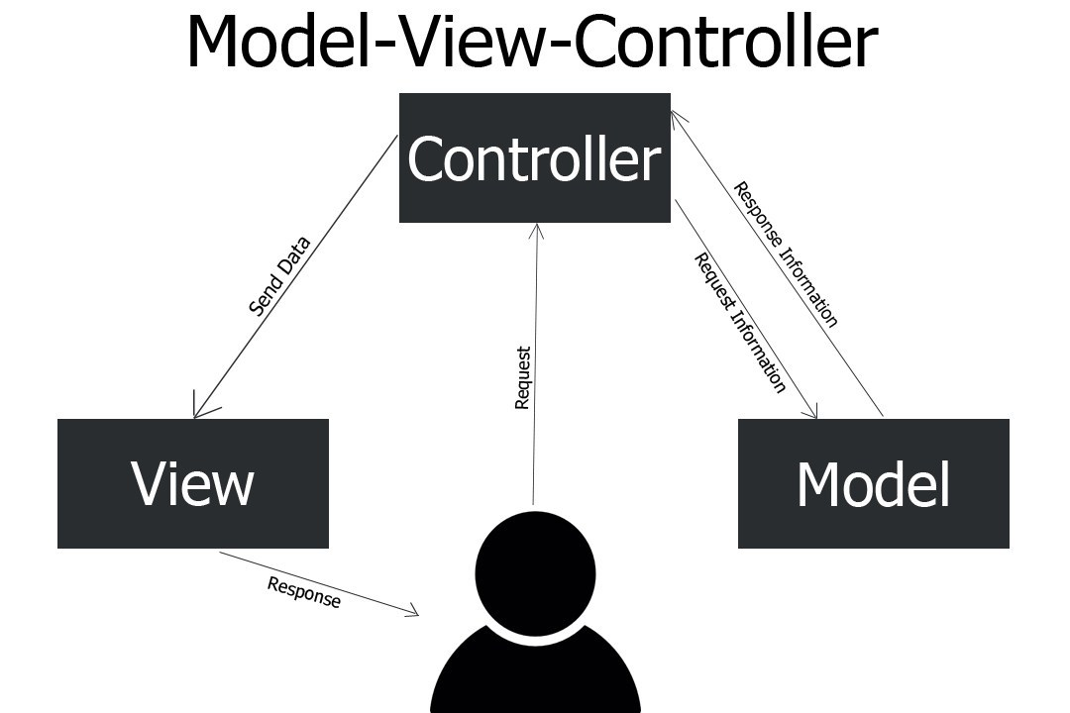
Design Pattern(MVC)

Slide 16
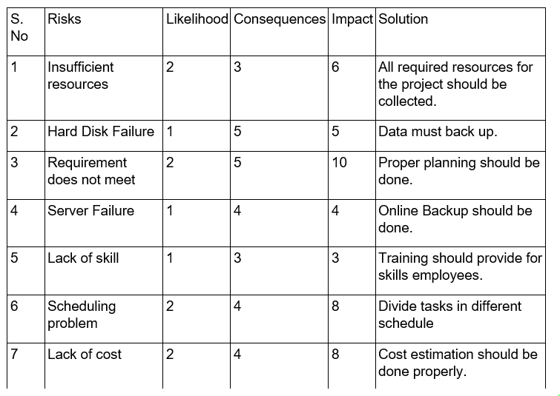
Risk Management

Slide 17
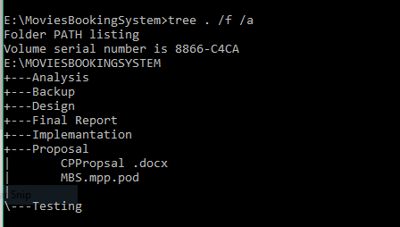
Configuration Management

Slide 18
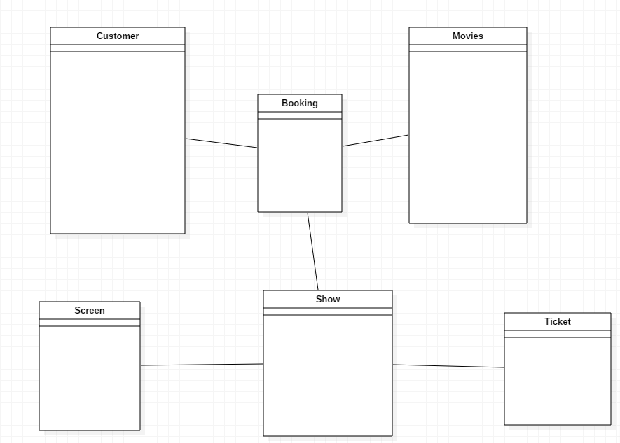
Design(Initial Class Diagram)

Slide 19
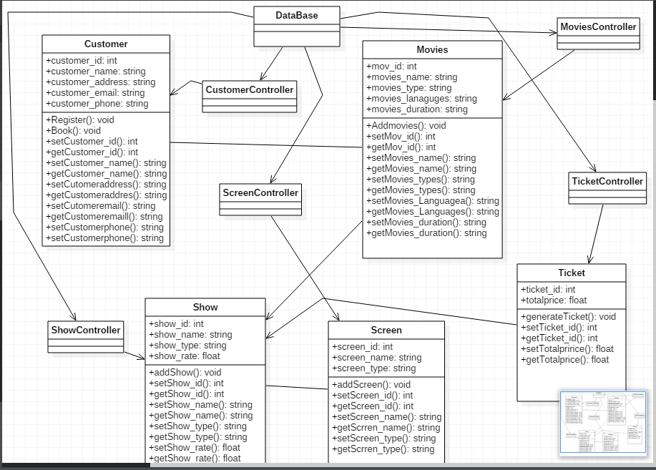
Design(Final Class Diagram)

Slide 20
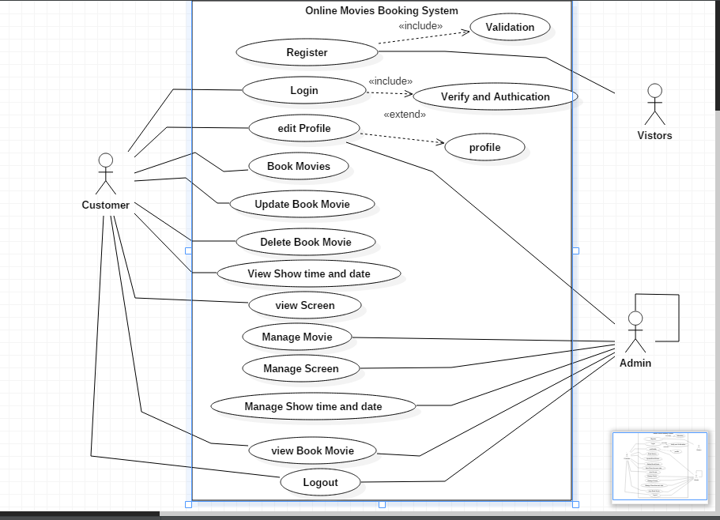
Design(Use-Case Diagram)

Slide 21
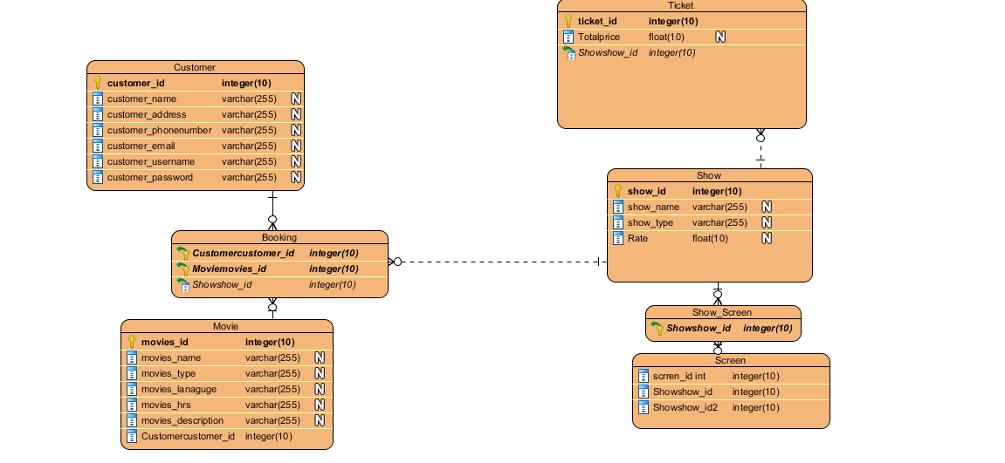
Er-Diagarm

Slide 22
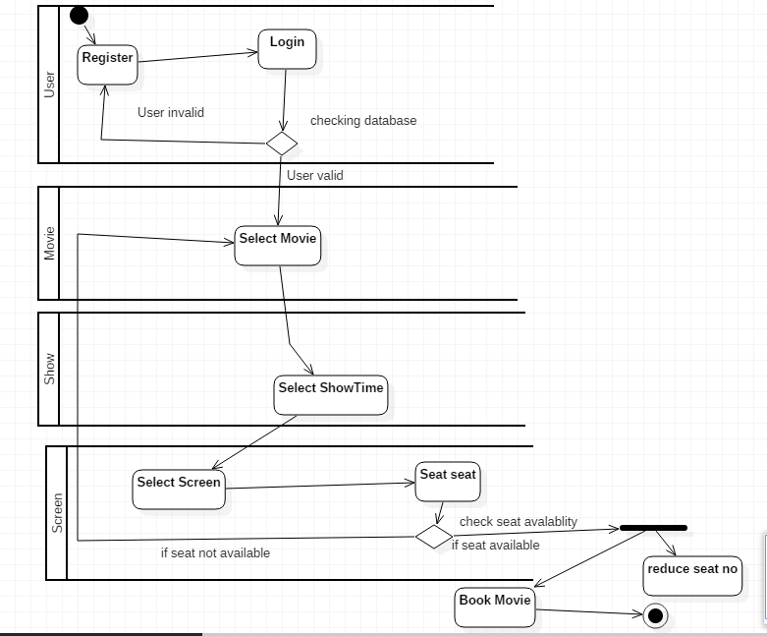
Activity Diagram

Slide 23
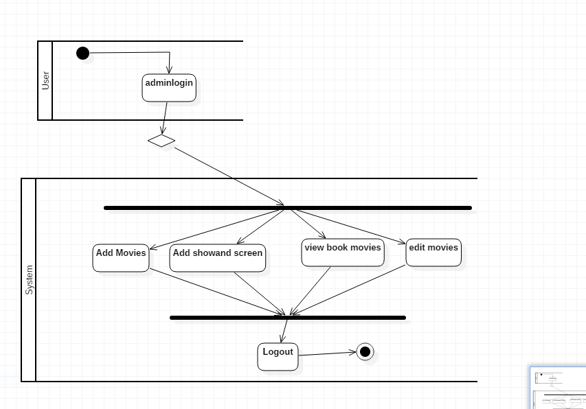
Activity Diagram

Slide 24
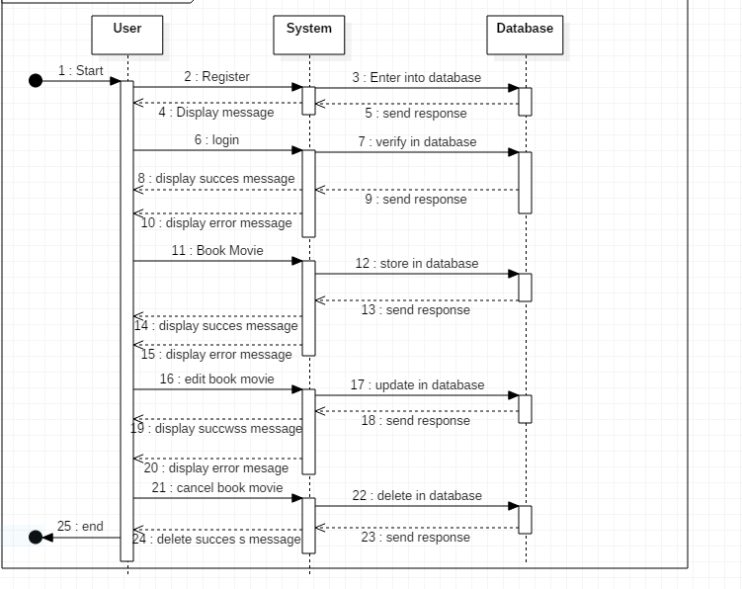
Sequence Diagram

Slide 25
Sequence Diagram

Slide 26
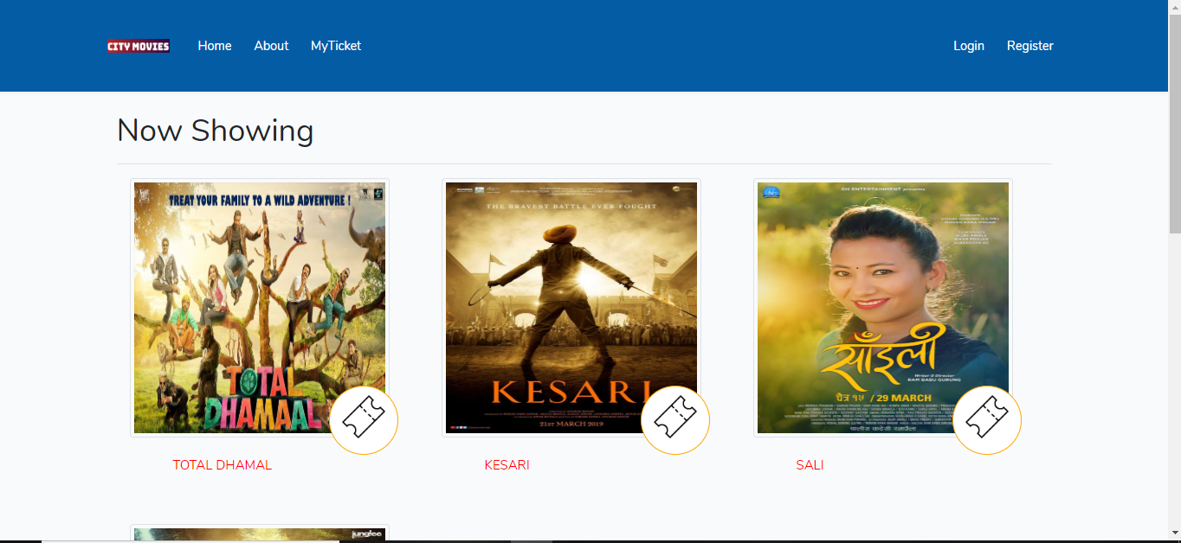
UI Design

Slide 27
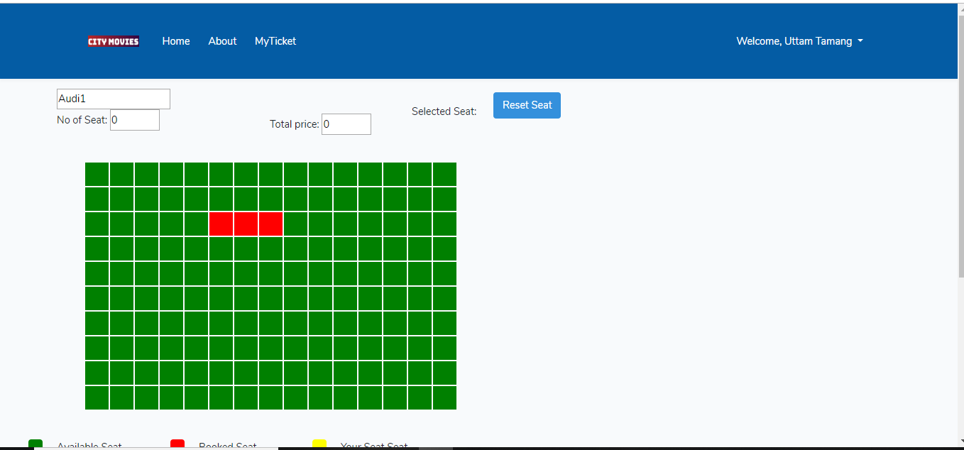
UI Design

Slide 28
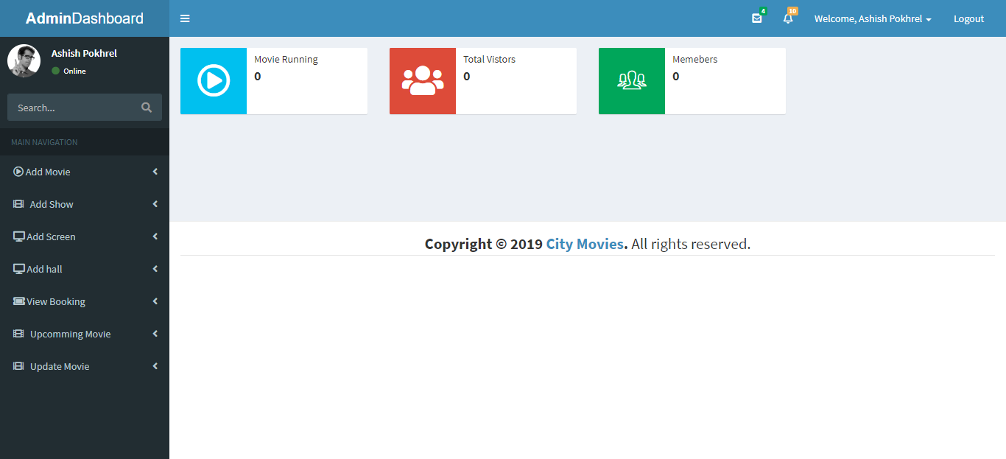
UI Design

Slide 29
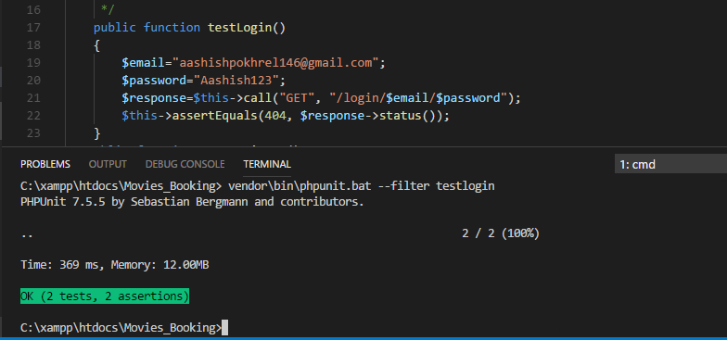
Test-Cases(Unit Testing)

Slide 30
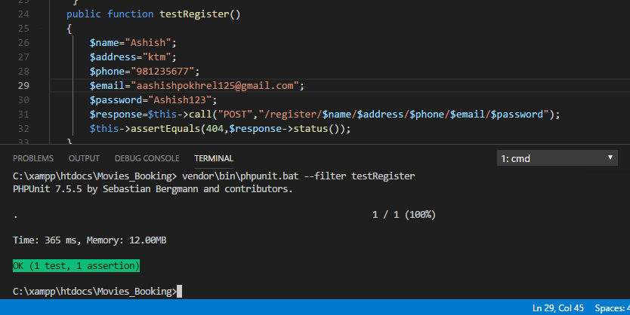
Test-cases(Unit testing)

Slide 31
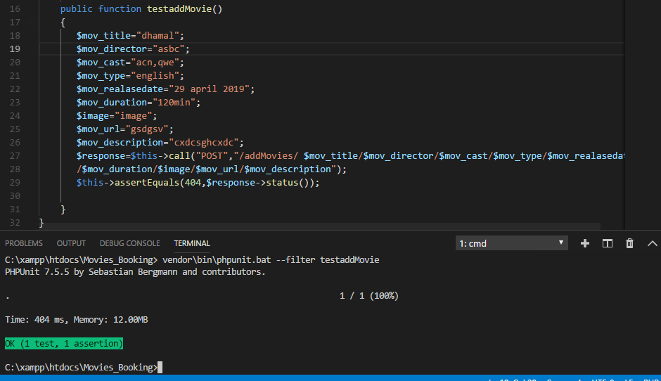
Test-cases(Unit testing)

